Slide 1
BMEN 4894 Biomedical Imaging Project: Fourier Reconstruction Method
Siheng He
Natalie Delpratt

Slide 2
Main Method
2-D Inverse
Fourier
Transform
2 Dimensional
Fourier-Object Space
F(ω_{x},ω_{y}) = FT(μ(x,y))
Object Space
μ(x,y)
X-ray absorption measurements yield
Radon Transform
Many slices
at different θ fill
2D Fourier-object space
1 Dimensional
Fourier-Radon Space
G(ω_{s}, θ) = FT(g(s))
Radon Space
g(s,θ)
1-D Fourier
Transform
FT(g(s))

Slide 3
Main Matlab Code
%%%%%%%%%%%%%%%%%%%%%%%%%%%%%%%%%%%%%%%%%%%%%%%%%%%%%%%%%%%%%%%%%%%%%
% Source data preparation
d_theta = 180 / N_theta;
theta = linspace(0,180-d_theta,N_theta);
Phantom = phantom(N_image);
axis = linspace(-(N_image-1)/2,(N_image-1)/2,N_image);
Radon = radon(Phantom,theta); % Apply Radon transform.
if ~isinf(SNRdB)
Radon = add_noise(Radon,SNRdB);
end
axis_s = linspace(-(size(Radon,1)-1)/2,(size(Radon,1)-1)/2,size(Radon,1));
if mode
save_result(axis,fliplr(axis),Phantom,'Original Image','x','y');
save_result(theta,axis_s,Radon,'Radon Transform','\theta','s');
end
Radon_pad = zeropad(Radon);
%%%%%%%%%%%%%%%%%%%%%%%%%%%%%%%%%%%%%%%%%%%%%%%%%%%%%%%%%%%%%%%%%%%%%
% 1D FOURIER TRANSFORM
[Fourier_Radon w_s] = apply_fft1(Radon_pad);
if mode
save_result(theta, w_s, log(abs(Fourier_Radon)),...
'Fourier Transform of Radon Space (Absolute Value in Log Scale)'...
,'\theta','\omega_s');
end
%%%%%%%%%%%%%%%%%%%%%%%%%%%%%%%%%%%%%%%%%%%%%%%%%%%%%%%%%%%%%%%%%%%%%
% INTERPOLATION: Map slices from polar coordinates to rectangular coordinates
[Fourier_2D w_xy] = polar_to_rect(theta,w_s,Fourier_Radon,N_image,method);
if mode
save_result(w_xy,fliplr(w_xy),log(abs(Fourier_2D)),...
'Interpolated Fourier Space From Raidal Grid to Cartesian Grid (Log Scale)'...
,'\omega_x','\omega_y')
end
%%%%%%%%%%%%%%%%%%%%%%%%%%%%%%%%%%%%%%%%%%%%%%%%%%%%%%%%%%%%%%%%%%%%%
% INVERSE 2D FOURIER TRANSFORM
[Reconstructed_image axis_xy_2] = inverse_Fourier_2D(Fourier_2D,w_xy);
%%%%%%%%%%%%%%%%%%%%%%%%%%%%%%%%%%%%%%%%%%%%%%%%%%%%%%%%%%%%%%%%%%%%%
Reconstructed_image = abs(Reconstructed_image);
if mode
save_result(axis,fliplr(axis),abs(Reconstructed_image),'Reconstructed Image'...
,'x','y');
end

Slide 4
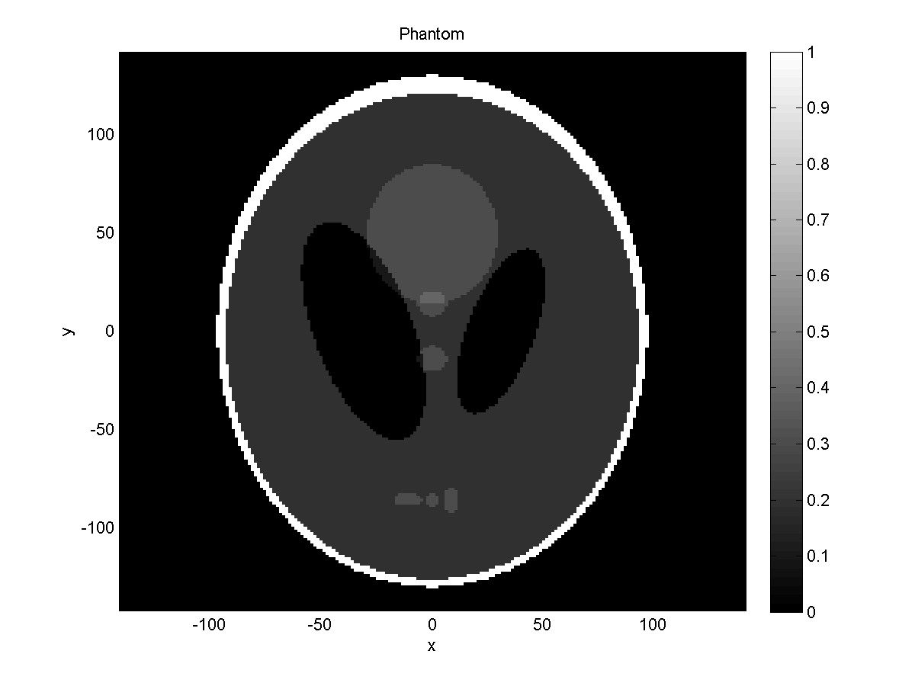
Original Data
Phantom Model Image
P = phantom(def, n) is the function used to obtain your test data and compare the accuracy of the functions radon vs. iradon.
The output of this fucntion, P, results as a grayscale image.
The Shepp-Logan phantom model was chosen since it is most used when doing tomography.
Used this image to perform our reconstruction method based on it’s Cartesian coordinate system.
Notes:
Reword what is in red.

Slide 5
1st Step: Creating Source Data
We had to pick a range of angles and projections to implant on our phantom model
N_theta is the number of projections chosen (180)
N_image is the size of the image (201x201 pixels)
Theta is an array of numbers determined by d-theta and N_theta, a range from 0 to 180˚.
d_theta = 180 / N_theta;
theta = linspace(0,180-d_theta,N_theta);
Phantom = phantom(N_image);
axis = linspace(-(N_image-1)/2,(N_image-1)/2,N_image);

Slide 6
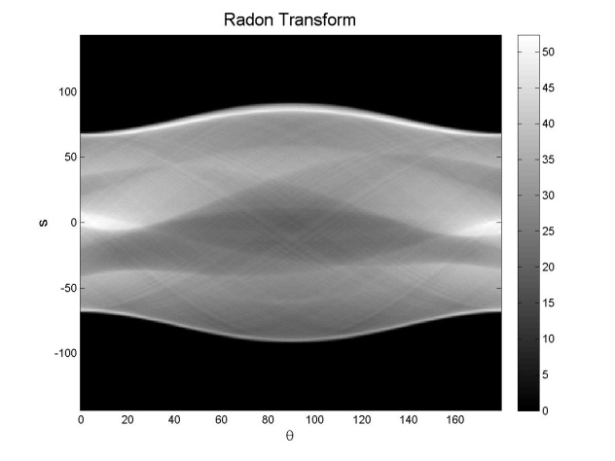

2nd Step: Radon Transform
The radon transform is the projection of a certain image defined along a line integral at a certain angle, $θ$.
The function radon was then performed on our source data, phantom head, based on our 180 projections.
Our output, the radon transform of our image, was labeled as Radon.
Each column in our matrix, Radon, is the radon transform at one angle theta.
The resultant radon transform of the phantom image is a sinogram.
x’
y’
s
θ
x
Radon Transform Process
Radon = radon(Phantom,theta);

Slide 7
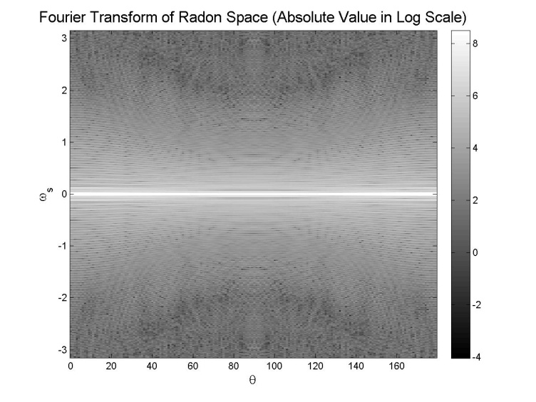
3rd Step: 1-D Fourier Transform
g(s,θ)
s
We took the 1-D Fourier Transform of the image in the radon space.
This takes us from the spatial domain to the frequency domain.
We first took the 1-D Fourier Transform of each column of Radon.
ω_{y}
y
1D-Fourier transform F(g(s))
θ
θ
x
ω_{x}
μ(x,y)
[Fourier_Radon w_s] = apply_fft1(Radon_pad);
Notes:
The highest frequency is at 0 because the since function is highest in the middle and decreases as you span out so the intensity increases.

Slide 8
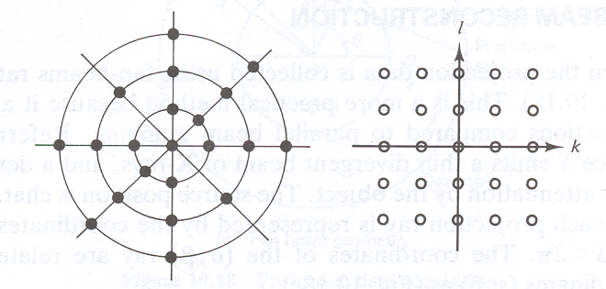
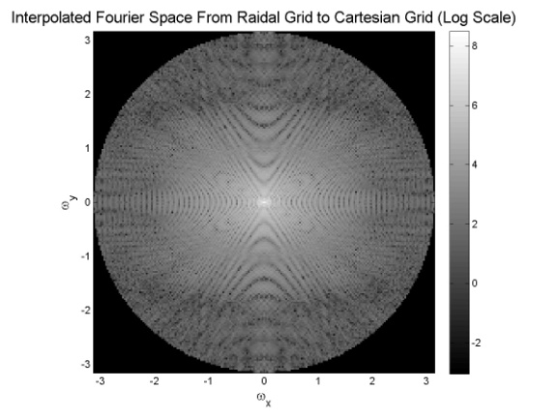

4th Step: Interpolaton
The purpose of interpolation is to change the coordinates from the Radial grid ($ω$_{s,}$θ$) or polar coordinates, into
2-D Cartesian coordinates.
Radial Grid Cartesian Grid
[Fourier_2D w_xy] = polar_to_rect(theta,w_s,Fourier_Radon,N_image,method);

Slide 9
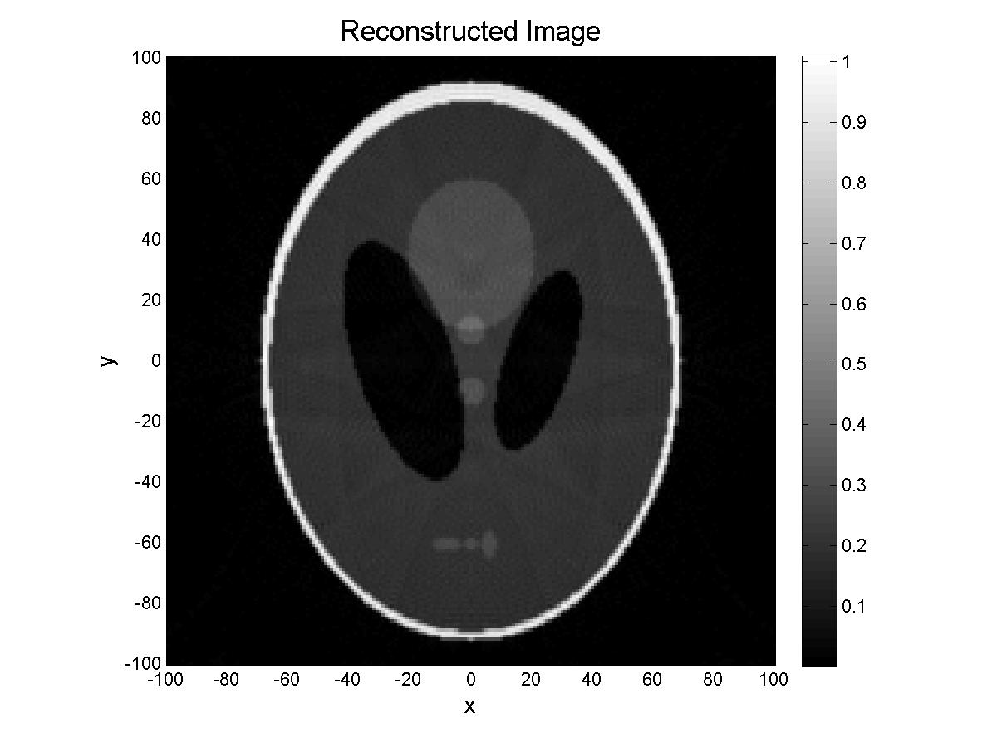
5th Step: 2-D Inverse Fourier Transorm
Once the data was transformed from polar to Cartesian coordinates we were better able to analyze our results.
As a result, we returned back to the spatial domain from the frequency domain.
[Reconstructed_image axis_xy_2] = inverse_Fourier_2D(Fourier_2D,w_xy);

Slide 10
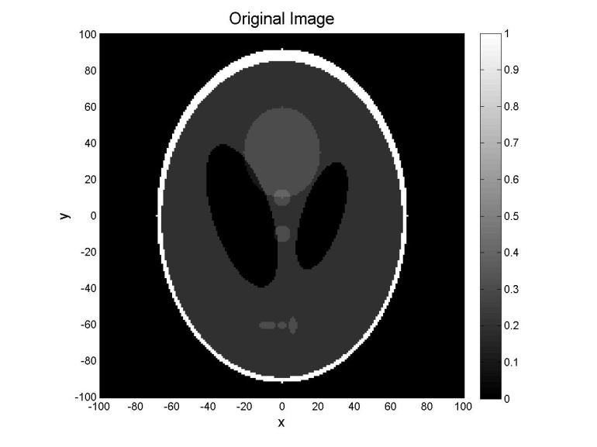

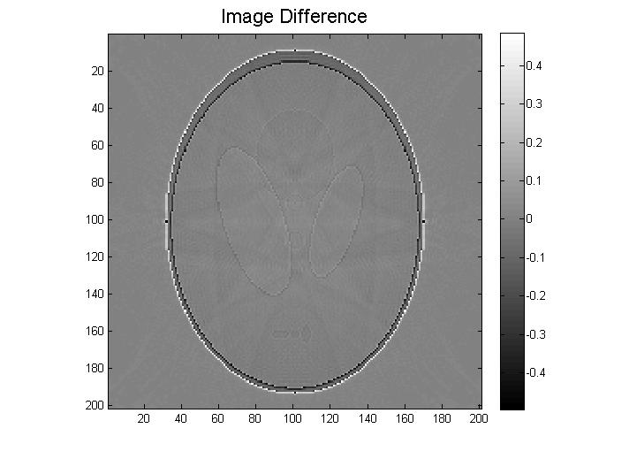
Summary
Notes:
Difference- determines if you get a good image or not. Take the value of each pixel and square it then add them up . If the number is small its good.

Slide 11
The effects of different parameters on the resultant image
Number of Projections
Image Size
Different Interpolation Schemes
Noise Tolerance
Resolution Limits

Slide 12
Number of Projections
The number of projections pertain to the number of slices that are processed through the object.
As the number of projection slices decrease, the image becomes more blurry and contain artifacts.
As the number of projection slices increase, the quality of the image becomes sharper and clearer.

Slide 13
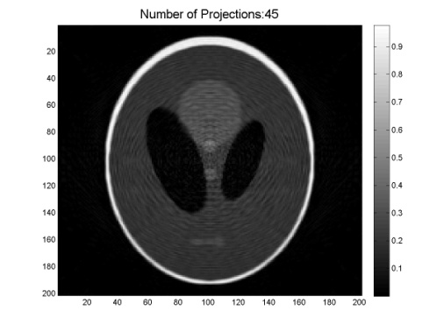
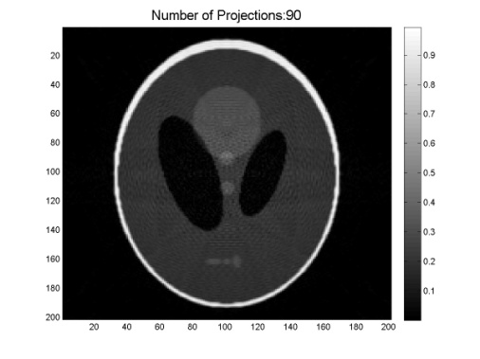


Results
 | SSE |  | Time Cost
Number of Projections | DFR | iradon | DFR | iradon
45 | 183.3997 | 306.0463 | 0.056596 | 0.00537
90 | 149.029 | 112.2927 | 0.076795 | 0.011519
180 | 128.156 | 91.9267 | 0.13572 | 0.01958
360 | 120.2064 | 89.2162 | 0.241939 | 0.037494
45 Projections (radon)
90 Projections (radon)
180 Projections (radon)
360 Projections (radon)

Slide 14
Image Size
Irregular.

Slide 15

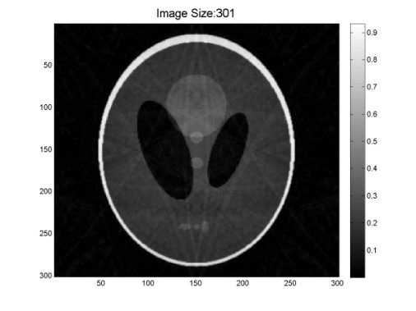


Results
 | SSE |  | Time Cost
Image Size | DFR | iradon | DFR | iradon
201 | 142.0425 | 91.9267 | 2.463262 | 0.02418
301 | 159.7715 | 67.35353 | 5.502602 | 0.03624
401 | 96.00835 | 57.83848 | 10.39842 | 0.063486
501 | 101.2656 | 56.43682 | 16.33764 | 0.109589
201
301
SSE normalized according to Image Size.
401
501

Slide 16
Different Interpolation Schemes
Nearest Point Method- will cause a lot of artifacts and give very high contrast.
Linear Method- will create clear images and take a short amount of time to compute.

Slide 17

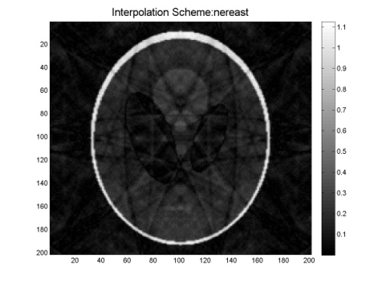

Results
 | SSE |  | Time Cost
Interpolation Scheme | DFR | iradon | DFR | iradon
Nearest | 291.1311 | 91.9267 | 0.135518 | 0.018948
Linear | 128.156 |  | 0.128465
Cubic | 109.2783 |  | 0.140448
Linear (radon)
Nearest (radon)
$SNR \left(dB\right)=20\log_{10 }\frac{signal}{noise variaion}$
Cubic (radon)

Slide 18
Noise Tolerance
Noise was added right after the radon transform to see how it would affect the data.
SNR Inf (radon)

Slide 19
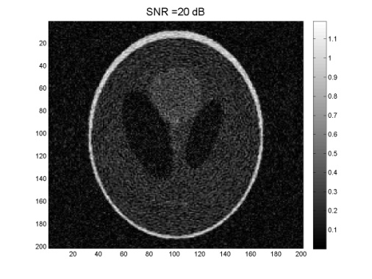



Results
 | SSE |  | Time Cost
Noise Level / SNRdB | DFR | iradon | DFR | iradon
No noise | 128.156 | 91.9267 | 0.137809 | 0.043952
60 | 128.1875 | 91.94332 | 0.133 | 0.0223
40 | 132.0015 | 94.53649 | 0.143402 | 0.025843
20 | 494.1461 | 345.8584 | 0.133453 | 0.025429
SNR 20dB ( radon)
SNR 40dB (radon)
SNR 60dB (radon)
SNR Inf (radon)

Slide 20
Resolution Limits
Process-make 2 lines. The distance between the 2 lines are delta x.
As you decrease delta x until you cant discriminate between those 2 lines.
That delta x is the resolution limit.

Slide 21
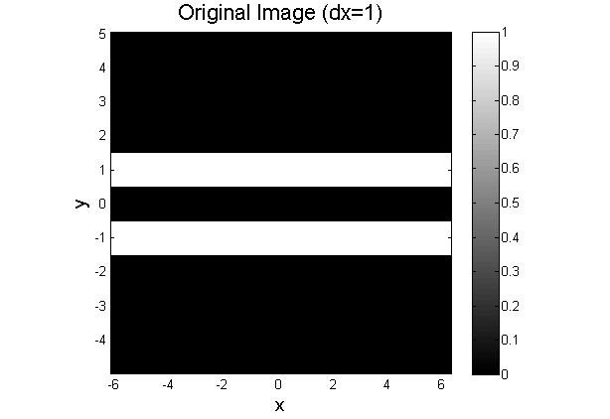
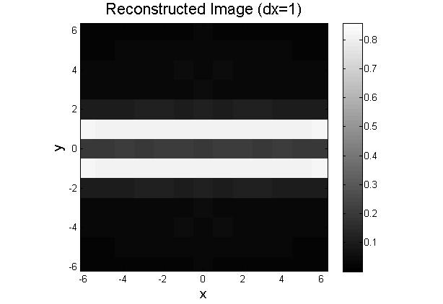
Results
Notes:
Bad resolution means you cannot discriminate the two white lines.

Slide 22
Acknowledgements and References
Professor Andreas H. Hielscher
Michael Ashraf

